Slide 1

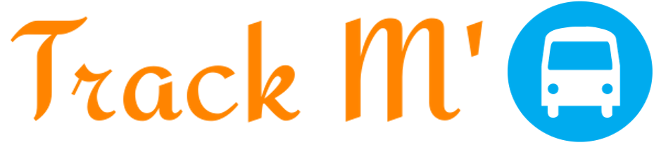
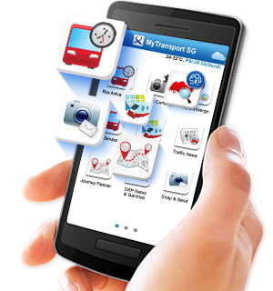
By Team Krypton

Slide 2
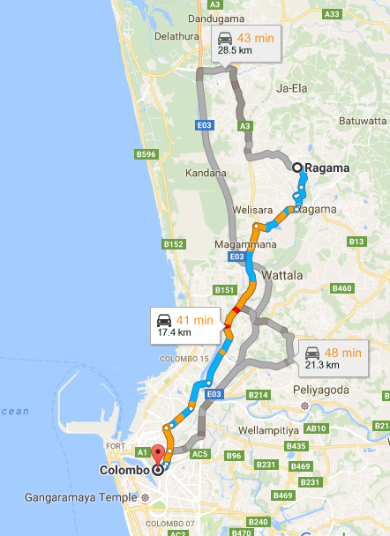
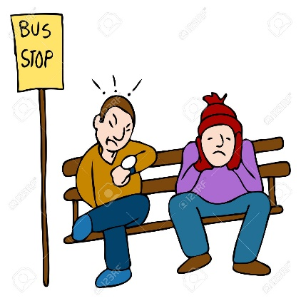

Problem
Passengers might wait long time for buses.
Passengers don’t know whether the bus comes or not.
Passengers don’t have any idea about the bus routes and bus fares.
Travelers don’t know how long it takes for the next bus.
Travelers are not aware of the buses and routes of new places.

Slide 3
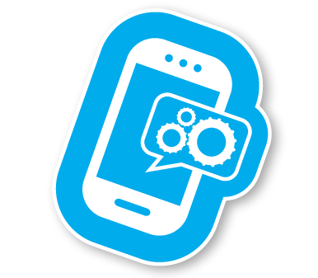


Solution
Mobile Application
Web Application

Slide 4

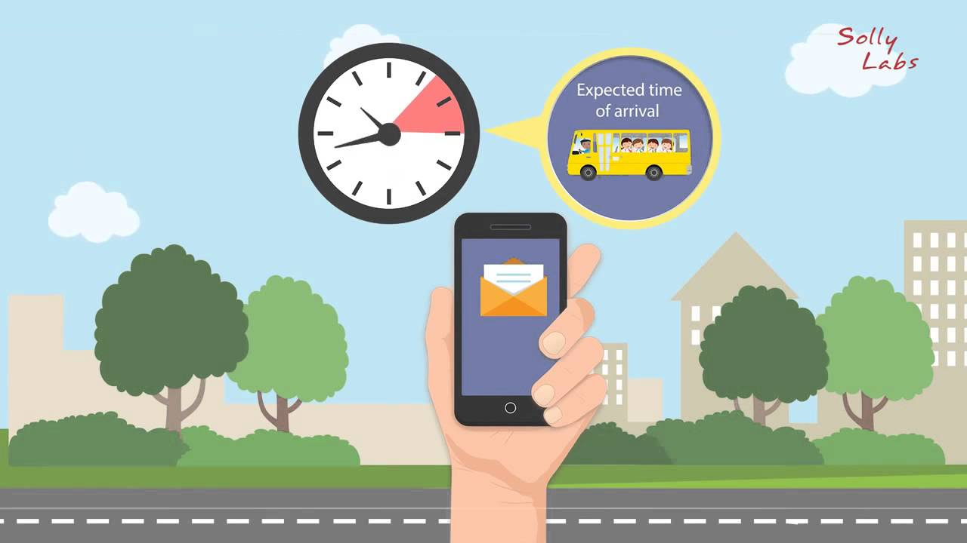
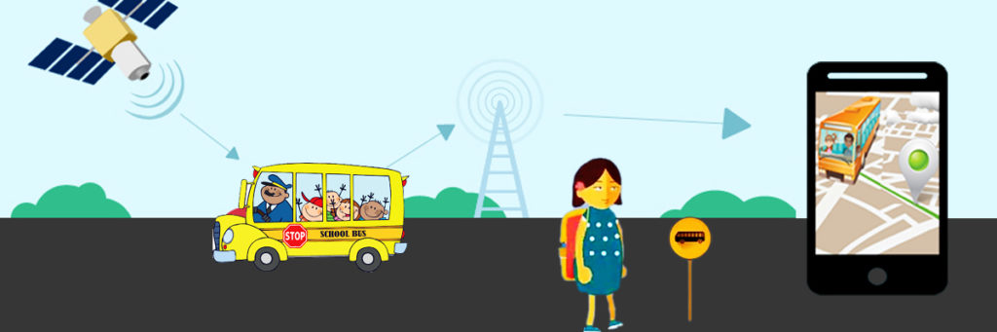
Benefits
Saves time.
Can plan for the route which costs less.
Avoid waiting for late or missed buses.
Bus department will get a total control over buses.
Increases the efficiency of bus drivers and conductors.
Increase the number of public transport travelers.

Slide 5
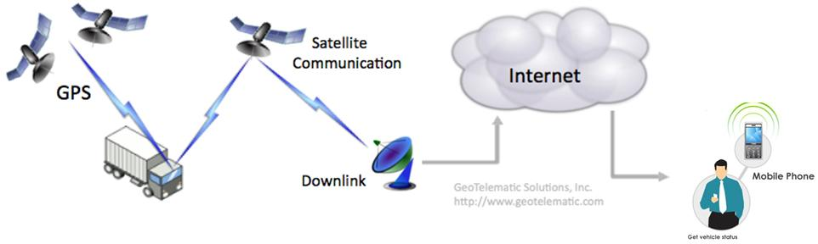

Architecture of the system

Slide 6





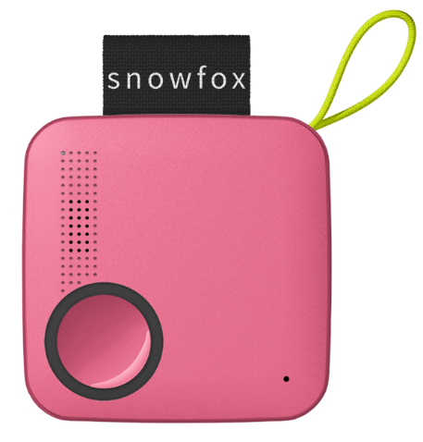

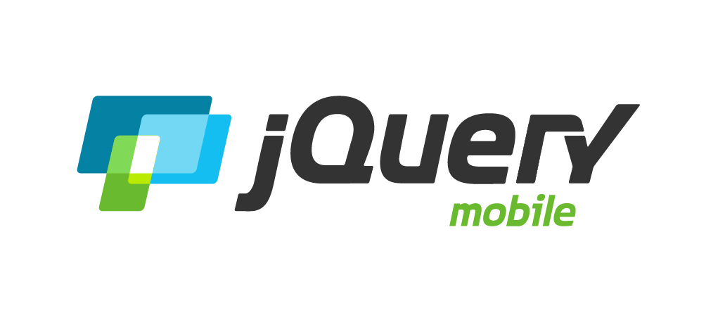

Underlying the magic

Slide 7

What is #Prime
A website for advertising

Slide 8

FUNCTIONAL REQUIREMENTS
Sign in & Signup of user
Select the bus root and watch the bus status and average time
Admin will manage the bus stops and the buses in the virtual map
User management and

Slide 9



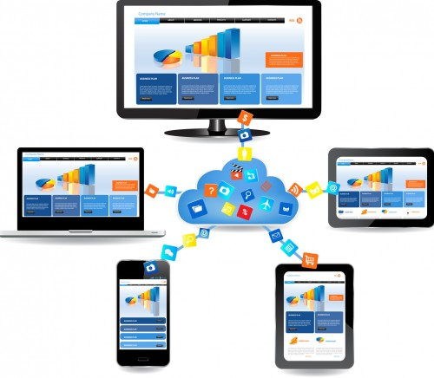



NON FUNCTIONAL REQUIREMENTS
Security
Reliability
Availability
Portability
Compatibility
User Friendly

Slide 10
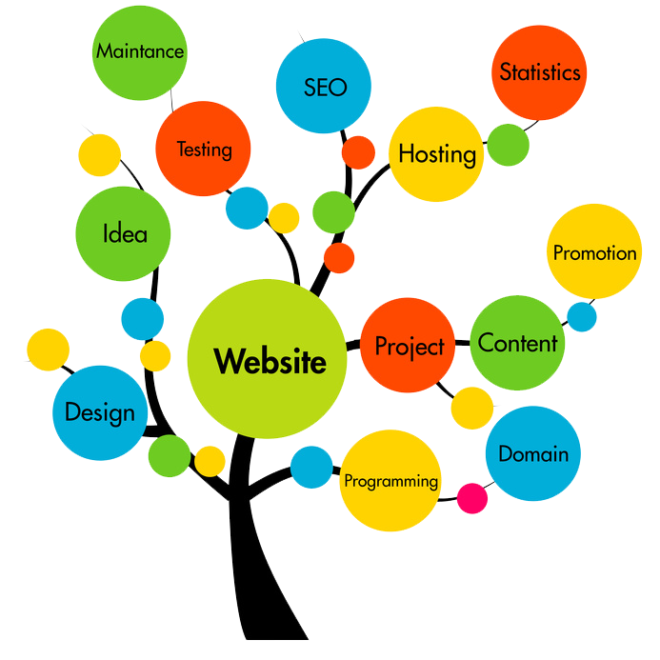
Best Practices
Naming conventions
Commenting
Coding indentation
Simple, intuitive and responsive user interfaces
On click application process
A common “war-rooms” style work area
Continuous integration
Use "leading-edge," not "bleeding-edge," technology.

Slide 11
Business Plan
Target Market
62%
Smart Phone Users who using Public Transport
(601 710 No of People)
Cost
Revenue
IOT Device – 15$ / Bus
Cloud – 120$ (Fixed Cost)
2$ / Registration
(Advertisement through the app)
Data From:- http://www.tradingeconomics.com/sri-lanka/population

Slide 12
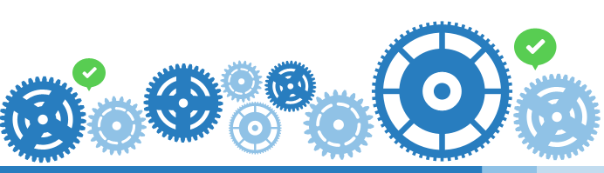

Deployment Plan
Launching the web application and the mobile application to the server.
Maintaining another server as the data backup.
Release updated versions.

Slide 13

Q & A

Slide 14
THANK YOU

